Slide 1
ENHANCING COMPETITIVENESS OF EXPORTING SMES UNDER THE ECONOMIC PARTNERSHIP AGREEMENT
Knowledge sharing on trade and investment Good practices
TRADECOM II PROGRAMME
22 February 2018

Slide 2
OUTLINE
SMES – MAURITIAN LANDSCAPE
KEY CHALLENGES FOR MAURITIAN SMES
TRADECOM PROJECT ON EXPORT COMPETITIVENESS
GAPS AND CONTRAINST
WAY FORWARD

Slide 3
SME LANDSCAPE IN MAURITIUS
Definition of SMEs in Mauritius
An enterprise with less than USD 1.5 million in annual sales
Contribution to the Economy
  40% of GDP
  55% Employment (301,000 workers out of 552 000)
  Less than 3% Exports
  In terms of value addition: USD 5 billion
  Aim : to make SMEs the engine of growth -Projected to contribution around 50% of the GDP by 2026 and increase exports to 18%

Slide 4
KEY CHALLENGES
Regulatory & Institutional Framework
Marketing and export capacity – Export Ready
Access to finance
Innovation and technology
Human Capital
Entrepreneur Culture

Slide 5
RESTRUCTURING SME ENVIRONMENT IN MAURITIUS- Development of the 2026 SME Master Plan
  Objective 1: Improve SME competitiveness and growth through
      improved productivity,
      better quality products and
      resiliency to compete in the global economy;
  Objective 2: Foster high growth potential SMEs by :
      nurturing start-ups and fostering entrepreneurship
      supporting knowledge-based activities and disruptive (innovators) SMEs
  Objective 3: Upgrade skills and job opportunities
      address skill mismatch/ and upgrade human capital
  Objective 4: Support SMEs to improve design and value addition
      research, development, innovation
  Objective 5: Increase market access and exports
  Market intelligence &market development

Slide 6
TRADECOM PROJECT
Start date: August 2017
Enhance the business environment for exporting SMEs; and
Promote exports of the Mauritius private sector including SMEs, Women and Young Entrepreneurs
OUTCOME: Improve ability of SMEs to become export ready
OBJECTIVES

Slide 7
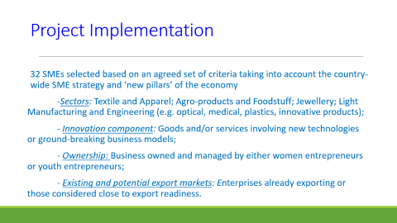
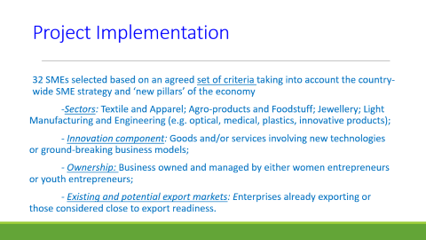
Project Implementation
32 SMEs selected based on an agreed set of criteria taking into account the country-wide SME strategy and ‘new pillars’ of the economy
-Sectors: Textile and Apparel; Agro-products and Foodstuff; Jewellery; Light Manufacturing and Engineering (e.g. optical, medical, plastics, innovative products);
- Innovation component: Goods and/or services involving new technologies or ground-breaking business models;
- Ownership: Business owned and managed by either women entrepreneurs or youth entrepreneurs;
- Existing and potential export markets: Enterprises already exporting or those considered close to export readiness.

Slide 8
GAPS AND CONSTRAINTS
SME sector has been let out
Lack or absence of institutional support for SMEs
Existence of various schemes for SMEs but not many can benefit from
Communication of schemes and facilities not efficient
No handholding is being carrried out by relevant institutions
Lack of management and financial management skills
SMEs had several visits of experts and training but did not help to solve their issues
Access to finance
Lack of information on Market access
Lack of Knowledge of markets to be targetted
Lack of knowledge of export clients
Lack of knowledge on marketing of products
Problems with quality on export markets
Limited export client database

Slide 9
Project Implementation
Result 1.1: Enhanced capacities of quality and standards in support of SMEs’ competitiveness attained
Quality management appears to be one of the main challenges faced by the selected businesses.
Visiting the SMEs allowed for an assessment of their individual needs. The key issues are related to their management, production processes and products.
Development of a Quality Standards Guide which was validated at a one day workshop held with the selected SMEs

Slide 10
Findings on Quality Management
Sector | Number of companies visited | Companies complying with some international standards | Companies seeking to comply with (more) international standards | Companies looking for support on compliance | Type of support needed
Apparel | 6 | 6 | 1 | 0
Agro-food | 3 | 3 | 1 | 2 | Information about EU rules ISO 9001 HACCP
IT | 2 | (1) | 0 | 0
Jewellery | 3 | 3 | 1 | 1 | Information about ISO 9001
Others | 6 | 2 | 2 | 2 | Information about ISO 9001
TOTAL | 20 | 14 (+1) | 5 | 5

Slide 11
Project Implementation
Result 1.2: Increased access to business intelligence services by SMEs
Developing a business model for an European Business Information centre (EBIC).
The proposed solutions are based on three case studies, i.e. Zimbabwe, Malaysia and Singapore’s experience in delivering export promotion and business intelligence services
Initially to be hosted by Enterprise Mauritius
Institutional Reforms lead to creation of Economic Development Board (EDB) regrouping Enterprise Mauritius, Board of Investment and Financial Services Promotion Agency
Proposed assistance to the creation of the EBIC

Slide 12
Project Implementation
Activity 2.1.1: Delivering business development and export marketing services for enterprises including women-owned businesses
Individual coaching sessions
Use of existing market access and export development opportunities through increased understanding of competitors (regional and international) and development of a core competitive advantage.
The methodology used to achieve these results is the Business Model Canvas approach which leads to defining a Unique Selling Proposition (USP) of each company, defining the Value Proposition to the client.

Slide 13
HOW THE TRADECOM PROJECT DIFFERS FROM OTHER PROJECTS
Handholding aspect of each individual SME by the consultants
Each enterprise is being visited by the Consultants
Working on their weaknesses and providing solutions to improve their performance
Selection of SMEs by stakeholders and consultants

Slide 14
Project Sustainability
Assistance end in March 2018
SME Mauritius along with Business Mauritius (Representing the private sector) and Association of Mauritian Manufacturers are working together to ensure the sustainability of the project.
The Consultants have, in this respect, been working together with the organisations to ensure a transfer of expertise and knowledge
Other SMEs will also be able to benefit from such an approach.
An MOU is in the process of being signed between the above institutions backed by a concept note on the modus operandi of the project’s next phase

Slide 15
Way forward
Crucial element: follow up on the project
The recommendations of the study to be monitored by SME Mauritius Ltd, a Government-owned Company, which has the mandate to promote and develop entrepreneurship, and provide the necessary support to SME’s.
A joint public-private working group on SME for Growth (SMEG JWG) will be created, where recommendations that require a collaborative process between public and private stakeholders can be driven.
Dedicated assistance to SMEs following constraints identified in respective companies
Request for further assistance to implement the recommendations of the study including the appointment of a project manager and facilitators on quality standards Business development, Business Intelligence services

Slide 16
THANK YOU

